Slide 1

Marquetry
Marquetry is the craft of covering a piece of furniture with veneer in the form of a skilfully applied design, pattern or picture.
Notes:
3-D wood block with texture and engraved text
(Advanced)
To reproduce the shape effects on this slide, do the following:
On the Home tab, in the Slides group, click Layout, and then click Blank.
On the Home tab, in the Drawing group, click Shapes, and then under Rectangles, click Rectangle (first option from the left). On the slide, drag to draw a rectangle.
Under Drawing Tools, on the Format tab, in the Size group, do the following:
In the Shape Height box, enter 3”.
In the Shape Width box, enter 3”.
On the Home tab, in the bottom right corner of the Drawing group, click the Format Shape dialog box launcher. In the Format Shape dialog box, click Fill in the left pane, and then in the Fill pane, select Picture or texture fill. Click the button next to Texture, and then click Oak (fifth row, third option from the left).
Also in the Format Shape dialog box, click Line Color in the left pane, and then in the Line Color pane, then select No line.
Also in the Format Shape dialog box, click 3-D Rotation in the left pane, and then in the 3-D Rotation pane, do the following:
Click the button next to Presets, and then under Perspective click Perspective Left (first row, second option from the left).
In the X box, enter 40°.
In the Y box, enter 10°.
In the Perspective box, enter 20°.
Also in the Format Shape dialog box, click 3-D Format in the left pane, and then in the 3-D Format pane, do the following:
Under Bevel, click the button next to Top, and then under Bevel click Circle (first row, first option from the left). Click the button next to Bottom, and then under Bevel click Circle (first row, first option from the left).
Under Depth, in the Depth box, enter 200 pt.
Under Surface, click the button next to Material, and then under Standard, click Warm Matte (second option from the left). Click the button next to Lighting, and then under Neutral, click Soft (first row, third option from the left). In the Angle box, enter 270°.
Also in the Format Shape dialog box, click Shadow in the left pane, and then in the Shadow pane, click the button next to Presets, and then under Perspective, click Perspective Diagonal Upper Right (first row, second option from the left).
To reproduce the text effects on this slide, do the following:
On the slide, right-click the rounded rectangle, click Edit Text, then enter text.
Select the text. On the Home tab, in the Font group, select Arial Rounded MT Bold from the Font list, and then select 36 from the Font Size list.
On the Home tab, in the Paragraph group, click Center to center the text within the rectangle.
Under Drawing Tools, on the Format tab, in the bottom right corner of the WordArt Styles group, click the Format Text Effects dialog box launcher. In the Format Text Effects dialog box, click Text Fill in the left pane, and then in the Text Fill pane, do the following:
Select Solid fill.
Click the button next to Color, click More Colors, and then in the Colors dialog box, on the Custom tab, enter values for Red: 130, Green: 101, and Blue: 58.
Also in the Format Text Effects dialog box, click Shadow in the left pane, and then in the Shadow pane, do the following:
Click the button next to Presets, and then under Inner click Inside Diagonal Top Left (first row, first option from the left).
In the Transparency box, enter 25%.
In the Distance box, enter 5 pt.
To reproduce the background on this slide, do the following:
Right-click the slide background area, and then click Format Background. In the Format Background dialog box, click Fill in the left pane, select Gradient fill in the Fill pane, and then do the following:
In the Type list, select Linear.
Click the button next to Direction, and then click Linear Down (first row, second option from the left).
Under Gradient stops, , click Add gradient stops or Remove gradient stops until four stops appear in the slider.
Also under Gradient stops, customize the gradient stops that you added as follows:
Select the first stop in the slider, and then do the following:
In the Position box, enter 0%.
Click the button next to Color, click More Colors, and then in the Colors dialog box, on the Custom tab, enter values for Red: 196, Green: 178, and Blue: 152.
Select the second stop in the slider, and then do the following:
In the Position box, enter 45%.
Click the button next to Color, and then under Theme Colors click Tan, Background 2, Darker 90% (sixth row, third option from the left).
Select the third stop in the slider, and then do the following:
In the Position box, enter 72%.
Click the button next to Color, click More Colors, and then in the Colors dialog box, on the Custom tab, enter values for Red: 66, Green: 62, and Blue: 50.
Select the fourth stop in the slider, and then do the following:
In the Position box, enter 100%.
Click the button next to Color, click More Colors, and then in the Colors dialog box, on the Custom tab, enter values for Red: 149, Green: 128, and Blue: 107.

Slide 2
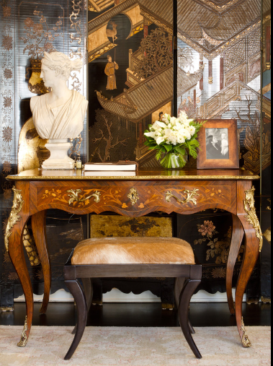
Marquetry patterns were typically flowers, instruments, birds or landscape scenes, all made from different wood veneers.
Wood veneers such as mahogany, walnut satinwood, tulipwood and many other exotic timbers.
A French-style 19th-century marquetry desk.
The drawers display flowers and vines The desk is also embellished with gold ormolu on the Queen Anne–style legs.
Image Houzz.com

Slide 3
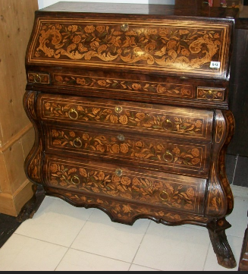
A Dutch Marquetry & Inlaid Desk

Slide 4
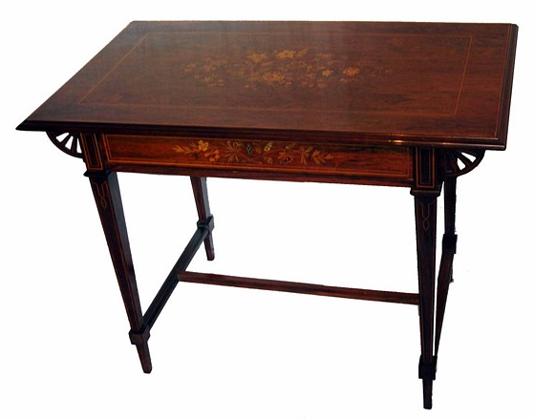
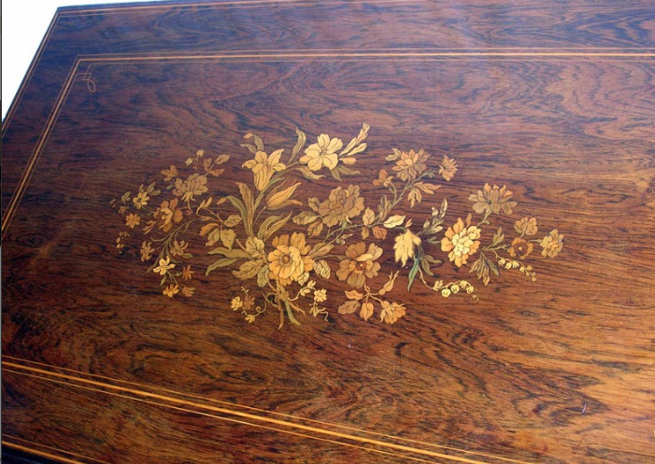
Sheraton style hall table Circa 1890

Slide 5
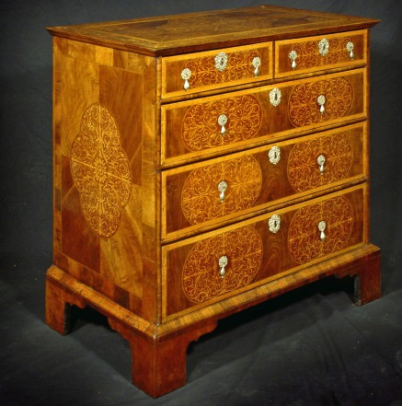
Seaweed Marquerty
Image hydeparkantiques .com
William & Mary circa 1705 value $68,000
This type of marquerty is very difficult to carry out because of the size and complexity of the work.

Slide 6
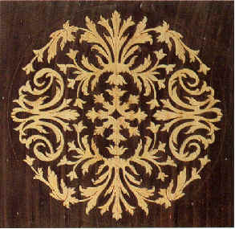
Seaweed Marquerty
Image Crispin veneers
Seaweed marquetry is also machine manufactured example shown is from Crispin veneers.

Slide 7
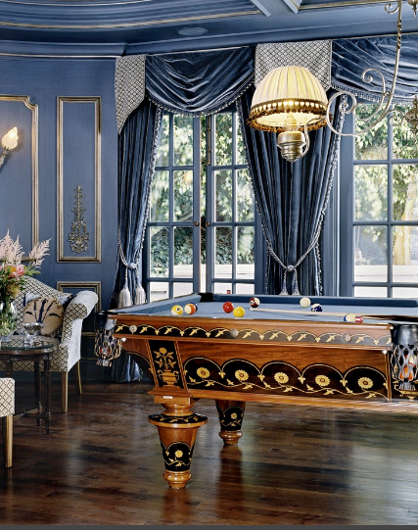
Modern Marquetry
Image Houzz.com
This pool table features several different wood grains. The different wood grains contrast one another beautifully.

Slide 8
Classic
Marquetry
Classic Marquetry is cutting several patterns at the same time.
Notes:
3-D wood block with texture and engraved text
(Advanced)
To reproduce the shape effects on this slide, do the following:
On the Home tab, in the Slides group, click Layout, and then click Blank.
On the Home tab, in the Drawing group, click Shapes, and then under Rectangles, click Rectangle (first option from the left). On the slide, drag to draw a rectangle.
Under Drawing Tools, on the Format tab, in the Size group, do the following:
In the Shape Height box, enter 3”.
In the Shape Width box, enter 3”.
On the Home tab, in the bottom right corner of the Drawing group, click the Format Shape dialog box launcher. In the Format Shape dialog box, click Fill in the left pane, and then in the Fill pane, select Picture or texture fill. Click the button next to Texture, and then click Oak (fifth row, third option from the left).
Also in the Format Shape dialog box, click Line Color in the left pane, and then in the Line Color pane, then select No line.
Also in the Format Shape dialog box, click 3-D Rotation in the left pane, and then in the 3-D Rotation pane, do the following:
Click the button next to Presets, and then under Perspective click Perspective Left (first row, second option from the left).
In the X box, enter 40°.
In the Y box, enter 10°.
In the Perspective box, enter 20°.
Also in the Format Shape dialog box, click 3-D Format in the left pane, and then in the 3-D Format pane, do the following:
Under Bevel, click the button next to Top, and then under Bevel click Circle (first row, first option from the left). Click the button next to Bottom, and then under Bevel click Circle (first row, first option from the left).
Under Depth, in the Depth box, enter 200 pt.
Under Surface, click the button next to Material, and then under Standard, click Warm Matte (second option from the left). Click the button next to Lighting, and then under Neutral, click Soft (first row, third option from the left). In the Angle box, enter 270°.
Also in the Format Shape dialog box, click Shadow in the left pane, and then in the Shadow pane, click the button next to Presets, and then under Perspective, click Perspective Diagonal Upper Right (first row, second option from the left).
To reproduce the text effects on this slide, do the following:
On the slide, right-click the rounded rectangle, click Edit Text, then enter text.
Select the text. On the Home tab, in the Font group, select Arial Rounded MT Bold from the Font list, and then select 36 from the Font Size list.
On the Home tab, in the Paragraph group, click Center to center the text within the rectangle.
Under Drawing Tools, on the Format tab, in the bottom right corner of the WordArt Styles group, click the Format Text Effects dialog box launcher. In the Format Text Effects dialog box, click Text Fill in the left pane, and then in the Text Fill pane, do the following:
Select Solid fill.
Click the button next to Color, click More Colors, and then in the Colors dialog box, on the Custom tab, enter values for Red: 130, Green: 101, and Blue: 58.
Also in the Format Text Effects dialog box, click Shadow in the left pane, and then in the Shadow pane, do the following:
Click the button next to Presets, and then under Inner click Inside Diagonal Top Left (first row, first option from the left).
In the Transparency box, enter 25%.
In the Distance box, enter 5 pt.
To reproduce the background on this slide, do the following:
Right-click the slide background area, and then click Format Background. In the Format Background dialog box, click Fill in the left pane, select Gradient fill in the Fill pane, and then do the following:
In the Type list, select Linear.
Click the button next to Direction, and then click Linear Down (first row, second option from the left).
Under Gradient stops, , click Add gradient stops or Remove gradient stops until four stops appear in the slider.
Also under Gradient stops, customize the gradient stops that you added as follows:
Select the first stop in the slider, and then do the following:
In the Position box, enter 0%.
Click the button next to Color, click More Colors, and then in the Colors dialog box, on the Custom tab, enter values for Red: 196, Green: 178, and Blue: 152.
Select the second stop in the slider, and then do the following:
In the Position box, enter 45%.
Click the button next to Color, and then under Theme Colors click Tan, Background 2, Darker 90% (sixth row, third option from the left).
Select the third stop in the slider, and then do the following:
In the Position box, enter 72%.
Click the button next to Color, click More Colors, and then in the Colors dialog box, on the Custom tab, enter values for Red: 66, Green: 62, and Blue: 50.
Select the fourth stop in the slider, and then do the following:
In the Position box, enter 100%.
Click the button next to Color, click More Colors, and then in the Colors dialog box, on the Custom tab, enter values for Red: 149, Green: 128, and Blue: 107.

Slide 9
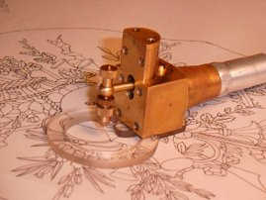
Many copies of the panel can be produced at the same time with very little effort
Identical copies of the original design are made using a "machine a pique".
This machine is like a system for making tattoos, and is used to pick the design onto a Kraft paper.
This "picked" pattern is used to create a dozen exact copies, which are cut up in the process.
The original "picked" pattern is saved for future use, and often remains usable for many decades.

Slide 10
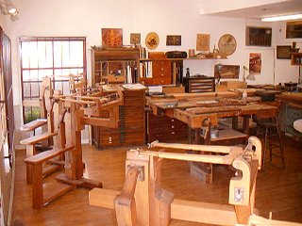

Cutting Marquetry Panels
The original pattern is glued onto some waste veneer.
A number of choice veneers are then sandwiched between two waste veneers and pinned together.
The bundle of veneers are the cut on a donkey / fret saw. As each section is cut out it is placed to one side.
Donkey saw
The Hegner Multicut-1
Fret saw

Slide 11
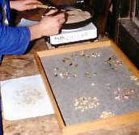
Cutting Marquetry Panels
One edge of each section of veneer is scorched by dipping it in hot sharp sand. This is called Sand shading and it gives the pattern a 3D effect.
The pattern is then recreated using the different veneers to give a number of panels.

Slide 12
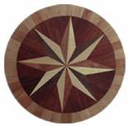
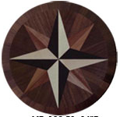


Same patterns using alternative veneers

Slide 13
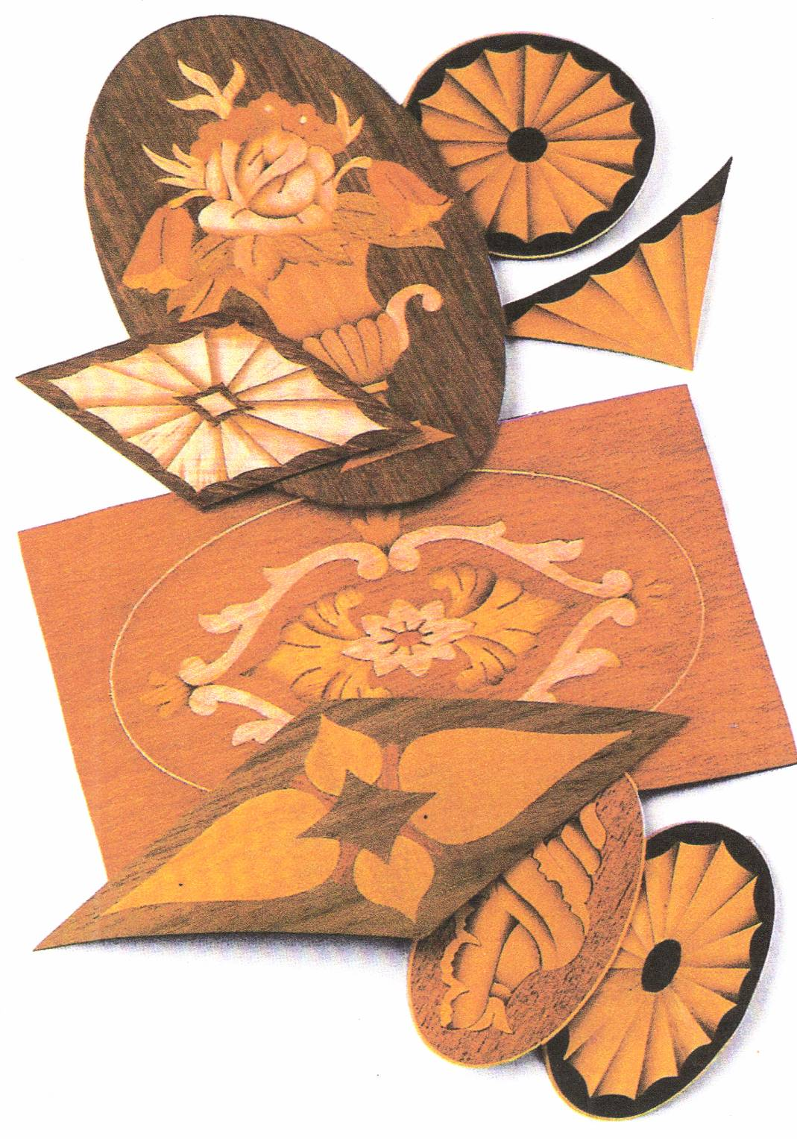
Examples of Marquetry panels

Slide 14
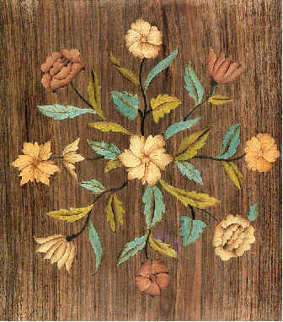
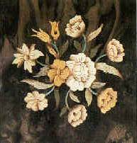
Floral patterns

Slide 15
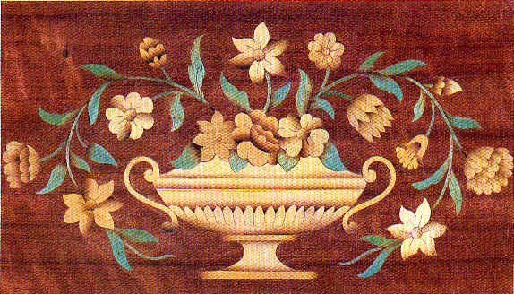
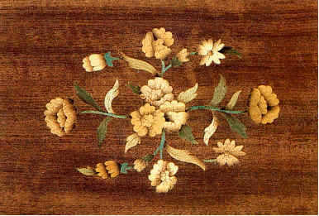
Floral patterns

Slide 16
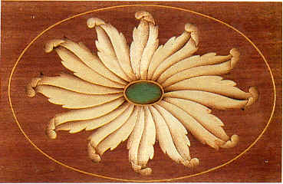
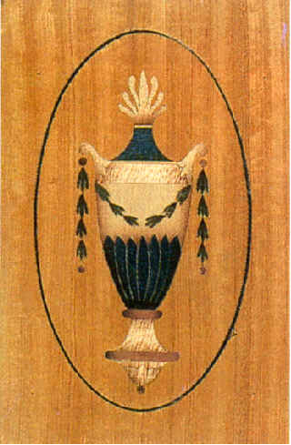
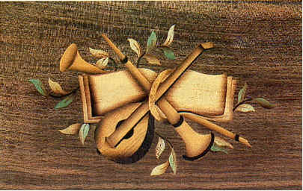
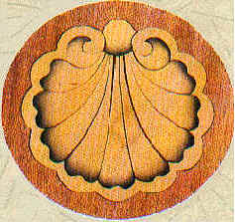

Slide 17
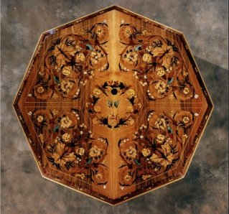
Table made in the American School of Marquetry
Thomas Chippendale Master Furniture Maker
Demo by Jack Metcalfe.
http://www.chippendaleactivities.org/fun_stuff.php?p=furniture_making_skills&v=marquetry

Slide 18
Picture
Marquetry
Picture Marquetry is creating beautiful pictures using skilfully cut veneers. Care in choosing colour, grain direction and size is a learned skill.
Notes:
3-D wood block with texture and engraved text
(Advanced)
To reproduce the shape effects on this slide, do the following:
On the Home tab, in the Slides group, click Layout, and then click Blank.
On the Home tab, in the Drawing group, click Shapes, and then under Rectangles, click Rectangle (first option from the left). On the slide, drag to draw a rectangle.
Under Drawing Tools, on the Format tab, in the Size group, do the following:
In the Shape Height box, enter 3”.
In the Shape Width box, enter 3”.
On the Home tab, in the bottom right corner of the Drawing group, click the Format Shape dialog box launcher. In the Format Shape dialog box, click Fill in the left pane, and then in the Fill pane, select Picture or texture fill. Click the button next to Texture, and then click Oak (fifth row, third option from the left).
Also in the Format Shape dialog box, click Line Color in the left pane, and then in the Line Color pane, then select No line.
Also in the Format Shape dialog box, click 3-D Rotation in the left pane, and then in the 3-D Rotation pane, do the following:
Click the button next to Presets, and then under Perspective click Perspective Left (first row, second option from the left).
In the X box, enter 40°.
In the Y box, enter 10°.
In the Perspective box, enter 20°.
Also in the Format Shape dialog box, click 3-D Format in the left pane, and then in the 3-D Format pane, do the following:
Under Bevel, click the button next to Top, and then under Bevel click Circle (first row, first option from the left). Click the button next to Bottom, and then under Bevel click Circle (first row, first option from the left).
Under Depth, in the Depth box, enter 200 pt.
Under Surface, click the button next to Material, and then under Standard, click Warm Matte (second option from the left). Click the button next to Lighting, and then under Neutral, click Soft (first row, third option from the left). In the Angle box, enter 270°.
Also in the Format Shape dialog box, click Shadow in the left pane, and then in the Shadow pane, click the button next to Presets, and then under Perspective, click Perspective Diagonal Upper Right (first row, second option from the left).
To reproduce the text effects on this slide, do the following:
On the slide, right-click the rounded rectangle, click Edit Text, then enter text.
Select the text. On the Home tab, in the Font group, select Arial Rounded MT Bold from the Font list, and then select 36 from the Font Size list.
On the Home tab, in the Paragraph group, click Center to center the text within the rectangle.
Under Drawing Tools, on the Format tab, in the bottom right corner of the WordArt Styles group, click the Format Text Effects dialog box launcher. In the Format Text Effects dialog box, click Text Fill in the left pane, and then in the Text Fill pane, do the following:
Select Solid fill.
Click the button next to Color, click More Colors, and then in the Colors dialog box, on the Custom tab, enter values for Red: 130, Green: 101, and Blue: 58.
Also in the Format Text Effects dialog box, click Shadow in the left pane, and then in the Shadow pane, do the following:
Click the button next to Presets, and then under Inner click Inside Diagonal Top Left (first row, first option from the left).
In the Transparency box, enter 25%.
In the Distance box, enter 5 pt.
To reproduce the background on this slide, do the following:
Right-click the slide background area, and then click Format Background. In the Format Background dialog box, click Fill in the left pane, select Gradient fill in the Fill pane, and then do the following:
In the Type list, select Linear.
Click the button next to Direction, and then click Linear Down (first row, second option from the left).
Under Gradient stops, , click Add gradient stops or Remove gradient stops until four stops appear in the slider.
Also under Gradient stops, customize the gradient stops that you added as follows:
Select the first stop in the slider, and then do the following:
In the Position box, enter 0%.
Click the button next to Color, click More Colors, and then in the Colors dialog box, on the Custom tab, enter values for Red: 196, Green: 178, and Blue: 152.
Select the second stop in the slider, and then do the following:
In the Position box, enter 45%.
Click the button next to Color, and then under Theme Colors click Tan, Background 2, Darker 90% (sixth row, third option from the left).
Select the third stop in the slider, and then do the following:
In the Position box, enter 72%.
Click the button next to Color, click More Colors, and then in the Colors dialog box, on the Custom tab, enter values for Red: 66, Green: 62, and Blue: 50.
Select the fourth stop in the slider, and then do the following:
In the Position box, enter 100%.
Click the button next to Color, click More Colors, and then in the Colors dialog box, on the Custom tab, enter values for Red: 149, Green: 128, and Blue: 107.

Slide 19
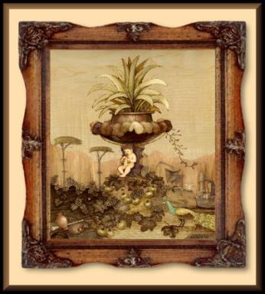
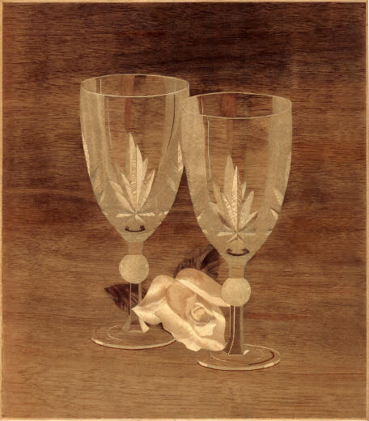
Picture Marquetry

