Slide 1
Adhesives
Wood Manufacturing & Finishing

Slide 2
Dermatitis
Dermatitis is an inflammation of the skin usually starting with irritation and redness.
Blisters may appear and when these break septic infection is liable to occur. Dermatitis is, however, not contagious.
Occupational Dermatitis is caused by contact of the skin with certain materials. The hands and arms are usually affected first.
Protection in the form of rubber gloves or barrier creams and general washing.

Slide 3
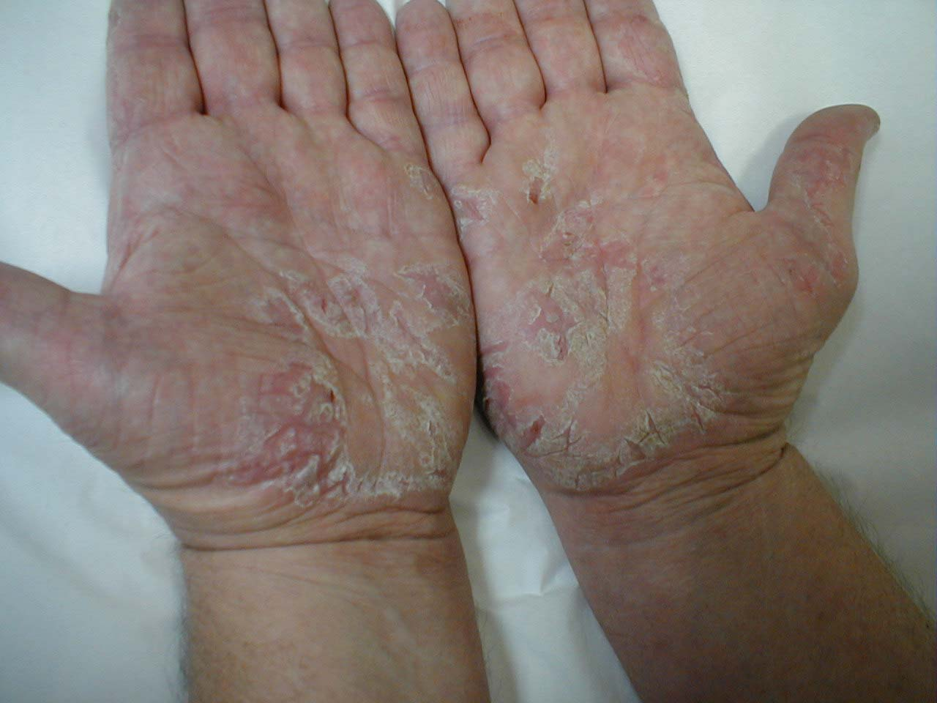
Dermatitis

Slide 4
Surface preparation.
The area receiving adhesive must be clean free from dust, grease, oil and dirt.
Adhesives should be applied at room temp. 18°. If applied in conditions colder that this or open time is too long then a thin skin forms on the glues outer surfaces called “chilling”.
Chilling can prevent the two glued surfaces from adhering properly and can cause the joint to break down or lamination to come apart.
If too much glue is used while veneering then the excess glue is forced up through the veneer’s grain and shows on the surface. This is called “show through”.

Slide 5
Surface preparation.
Adhesives set by many different ways.
Temperature change, solidify on cooling.
Evaporation of water or solvent.
Chemical change.
Because adhesives set in different ways they can never be intermixed.
Be careful mixing brands of adhesives in one job application as the chemical components could be different thus preventing adhesion.
Mitre Bond only use the activator that came with the adhesive.

Slide 6
Adhesives
Three main types of adhesives
Animal Glue:(animal bones & hide & fish offal )
Vegetable Glue:(dextrine, rye, soya bean flour & rubber latex)
Mineral Glue:(synethic resins, coal tar & crude oil)

Slide 7
Animal glue / Hide glue
This glue must be heated in a glue pot (water jacked pot) & applied hot. Available in slab, pearl, granules or powder.
Advantages of Animal Glue Strong, great for curved veneering. Veneer can be re-softened when set and repositioned. Glue can be reheated and reused again. Cheap.
Disadvantages of Animal Glue Has to heated before use and applied hot. Can be quite pungent. Short Pot life. Quite messy.

Slide 8
Vegetable Glue
Vegetable glues are mainly for making plywood and other veneered products (interior use)
These glues are usually prepared by the user by heating the vegetable-starch powder with water and then cooling the mixture to room temperature before use.
Some ready to use in liquid form.
Vegetable glues set by water evaporation.
They produce joints of high dry
strength but with low water and moisture resistance.
Impact / Contact glue: Rubber latex glues are used for leather work and upholstery and also for laying plastic laminates.

Slide 9
Mineral Glue: Urea formaldehyde: Used in manmade boards eg. M.D.F, chipboard & O.S.B.
Advantages of Urea Formaldehyde Strong, water resistant, setting times can be speeded up with heat, great for pattern veneering, when set it is heat resistant
Disadvantages of Urea Formaldehyde Expensive, has to be weighed and mixed, can cause allergic reactions i.e. dermatitis, short pot life, dulls tool edges, fairly short shelf life, open bag can become air set.

Slide 10
Mineral Glue:
Phenol formaldehyde: Used for making plywood and Laminated plastics.
Resorcinol formaldehyde: Glue-lam beams found in leisure centres, shopping centres etc.
Epoxy resin: Bonds non porous material such as glass, plastic & metal.

Slide 11
Mineral Glue:Polyvinyl acetate (P.V.A.): Available interior and exterior grade for all types wooden joints
Advantages of P.V.A. Glue
Strong, in veneering setting times can be speeded up with heat, use straight from bottle. Exterior grade is water resistant.
Disadvantages of P.V.A. Glue Some grades take up to 1hr to set. If not cleaned off properly orange staining can occur when applying polish or lacquer. Reacts with metal and tannic acid in certain timbers to give blue staining

Slide 12
Synthetic resins are either gap filling or veneering (close contact) glues.
Separate application glues: these glues are used with a catalyst or hardener, its only function is to control setting time. Coat one side with glue one side with hardener
Mixed application glues: liquid or powder glue and hardeners are weighed and mixed prior to application. eg. U.F. glue for veneering – curing time is speeded up with heat.
Some glues like Cascamite are already premixed and by adding water the chemical process starts and the glue starts to set.

Slide 13
Epoxy resin: These glues are two creams that have to be mixed together before use. Some brands are sold in a double syringe that expels equal amounts of both creams. Used for bonding metal, glass, plastic & wood.
Impact / Contact glues (Neoprene): These are either synthetic or natural rubber latex glues in solvents and set by evaporation. Used for laying veneers on shaped rims, laying plastic laminates.

Slide 14
Laying plastic laminate on chipboard.
Apply contact adhesive to the chipboard allow 10mins until its tacky.
Apply contact adhesive to the Laminate and to the chipboard and leave until both become tacky
Position laminate on chipboard then press firmly expelling all air.
Leave until set then Trim.
Health & Safety
This is highly flammable so safety precautions are needed when using i.e. no naked flame, good ventilation,
Fumes can cause burning to eyes and respiratory system so a mask and goggles should be worn for prolonged use

