Slide 1
Furniture Joints

Slide 2
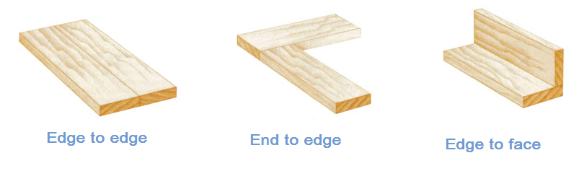
Butt Joints
A butt joint is made when two pieces of wood are butted together and glued.

Slide 3
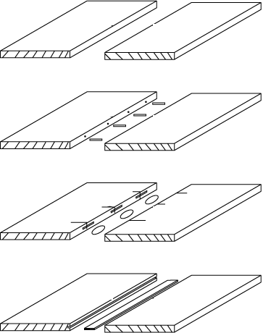
Name These Edge Joints
Rubbed glue joint
a
Dowel joint
b
Biscuit joint
c
Loose tongue joint
d
Comb joint, Tongue & groove & Slotted joint screw joint.

Slide 4
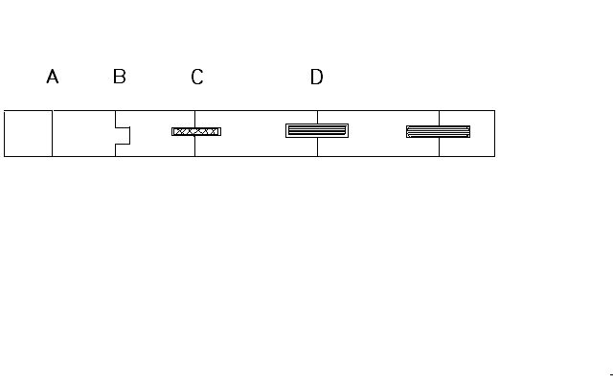

Name these joints
E

Slide 5
Name these joints
E
A : Rubbed Glue Joint
B : Tongue & Groove Joint
C : Biscuit Joint
D : Loose Tongue
E : Dowel Joint
Scarf Joints

Slide 6
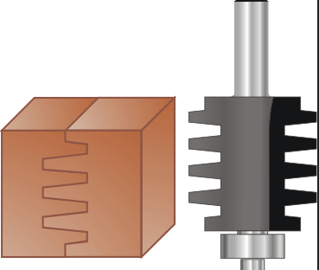
Comb joint

Slide 7
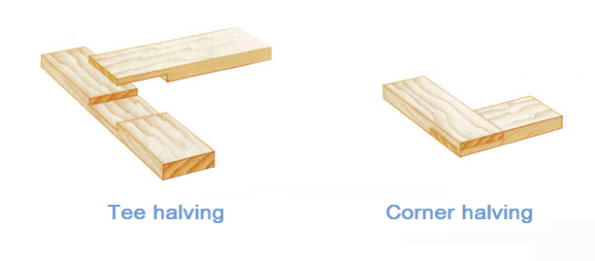
Having / Lap joints
Lap joints are created when two pieces of wood overlap one another at a right angle. Very simple form of jointing.
Can you name another type of having?

Slide 8
Mortise & Tenon
The mortise and tenon joint is one of the strongest traditional furniture joints. Usually found on good quality furniture.
It was sometimes reinforced with wedges, pegs or keys.
Lots of variations of these joints based on material being jointed and function of joint.

Slide 9
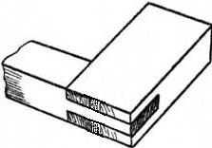
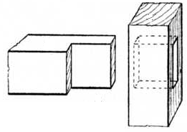
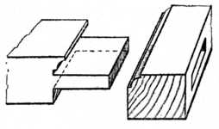
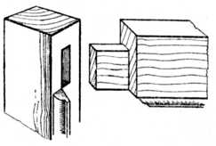
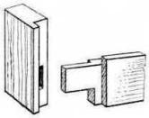
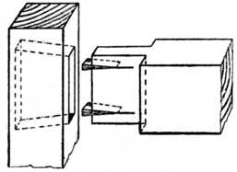
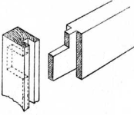
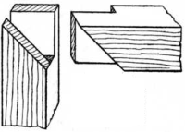
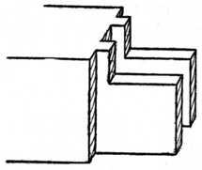
Name these joints
1
2
3
4
5
6
7
8
9

Slide 10
Name these joints
1 Bridle joint
2 Barefaced M & T
3 Scribed M & T
4 Mitred M & T
5 High & Low Shoulder
M & T
6 Fox wedged M & T
7 Haunched M & T
8 Corner Mitred
Bridle joint
9 Twin Tenon

Slide 11
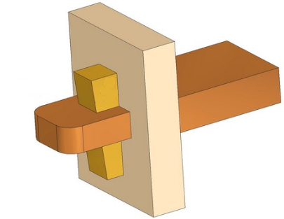
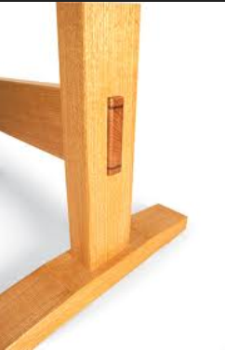
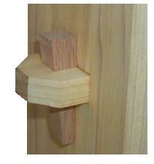
Keyed Mortice and Tenon

Slide 12
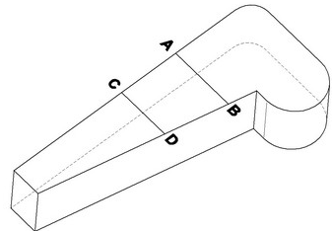
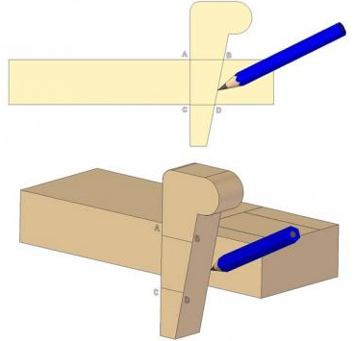
Craftsmanspace
Free technical plans, books, patterns, software
How to mark out a Key
http://www.craftsmanspace.com/knowledge/keyed-mortise-and-tenon-joint.html

Slide 13
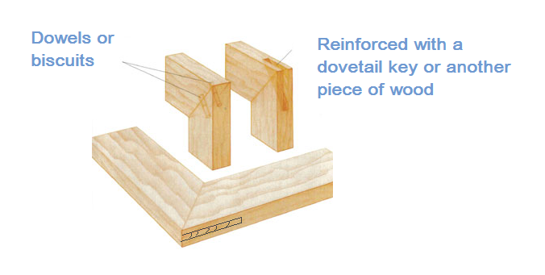
Corner Mitre Joints
The mitre joint usually cut at 45 degrees, on the ends of two pieces of wood, used on frames.
Mitred bridle joint
Can you name this bottom joint

Slide 14
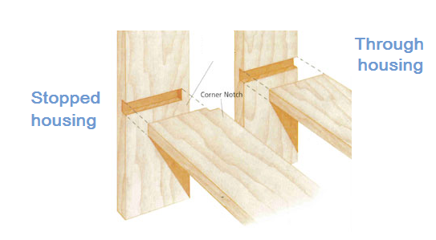
Housing joints
Jointing across the width shelf to side.
Can you draw Rebate housing, Dovetail housing

Slide 15
Dovetails
The dovetail joint is one of the most distinctive and best antique furniture joints used in furniture construction to join wood at a right angle.
Recognised by the angled pieces that replicate doves’ tails.
They form a strong interlock able joint with a large gluing area.
Used for joining carcass ends and for creating drawers.
Wide variations available, used as features on high class furniture.

Slide 16
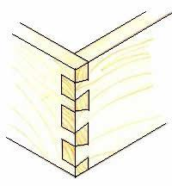
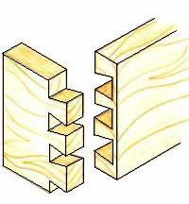
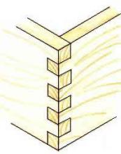
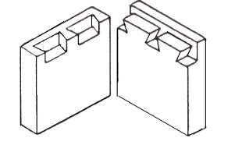
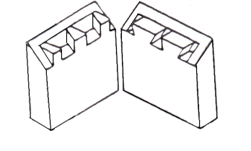
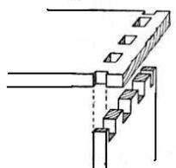
Carcase Joints
1
2
3
4
6
5

Slide 17
Carcase Joints
1 Through Dovetail
2 Lapped Dovetail
3 Finger Joint
4 Double Lapped
Dovetail
6 Through Pinned
Joint
5 Secret Mitre Dovetail

Slide 18
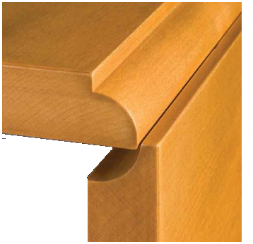
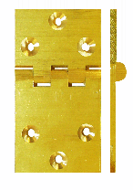
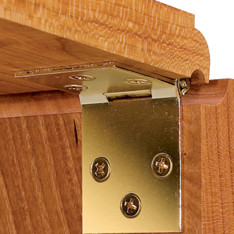
Rule Joint
This joint is used on drop leaf tables. The rule joint is jointed
together using a rule joint hinge. The hinge has one leaf
longer than the other why?
Rule joint hinge. Image from
woodworkersjournal.com

Slide 19
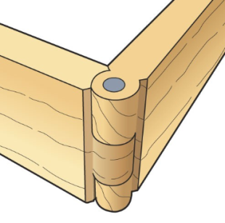
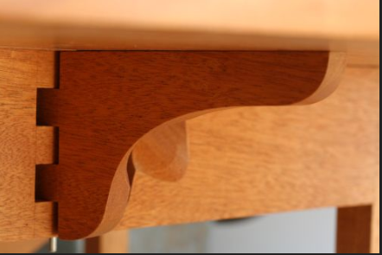
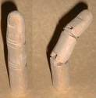
Knuckle Joint
Traditional moveable joint used on drop leaf tables

Slide 20
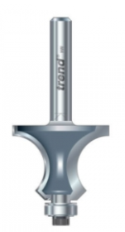
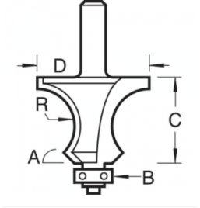
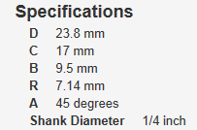
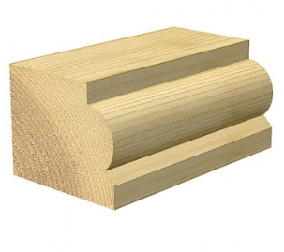
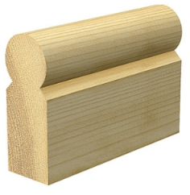
Trend 9/41 Knuckle Joint Cutter
Cutter should be used in router table

Slide 21
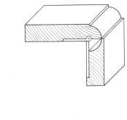
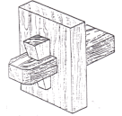
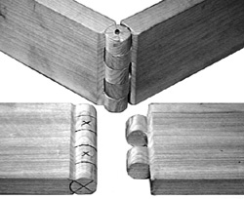
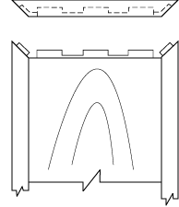
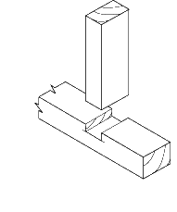
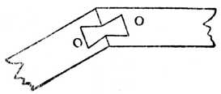

Name these joints
1
2
3
4
5
6

Slide 22
Name these joints
1 Rule joint
2 Projected wedged
mortise & tennon
3 Knuckle joint
4 Dovetail Key
5 Tennoned &
mitred clamped
6 Housing joint

Slide 23
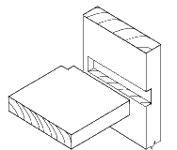
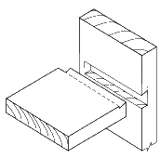
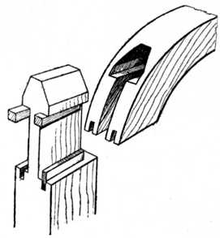
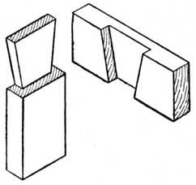
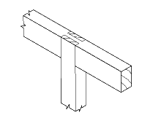
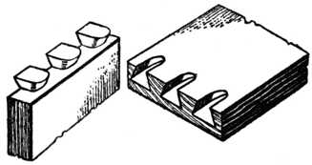
Name these joints
1
2
3
4
5
6

Slide 24
Name these joints
1 Stopped Housing
2 Stopped Dovetail
Housing
3 Hammer Head
Tenon joint
4 Dovetail Halving
5 Machine Dovetails
6 Bridle Joint

Slide 25

Modern Jointing

Slide 26

Dowels
Dowels a fast way of jointing.
Holes need to be aligned accurately.
Different patterns that allow glue to spread.

Slide 27



Biscuits
Biscuits a faster way of jointing, small allowance for accuracy.

Slide 28


Domino
Cross between a dowel and a biscuit you get a domino tenon
Festool domino joiner

Slide 29

Beadlock Pro
Alternative to the mortice and tenon something similar to using a false tennon.

Slide 30


JessEm Slip slot mortise mill
This is based on false tenons. It is a jig and custom made
drill bit that can be used in any handheld drill.
http://www.youtube.com/watch?v=_VtVGnxlBrc

