Slide 1
Knock Down
Fittings

Slide 2
What does KD stand for? ____________________________________________
Why were KD fittings were originally designed?________________________________________________________________________________________________________________________________________________________________________
____________________________________________________________________________________________________________________________________
What materials are used in the making of these fittings? ____________________________________________
What are the advantages of KD Fittings?
____________________________________________
____________________________________________________________________________________________________________________________________________________________________________________________________________________________
What are the disadvantages of KD Fittings?
________________________________________________________________________________________________________________________________________________________________________________________________________________________________________________________________________

Slide 3
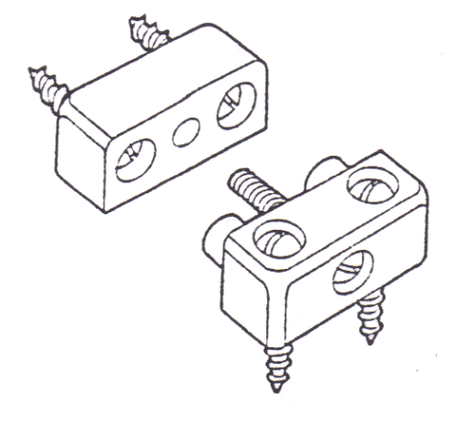
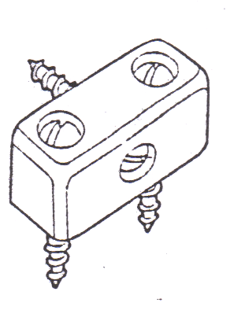
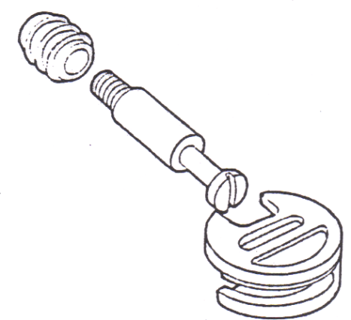
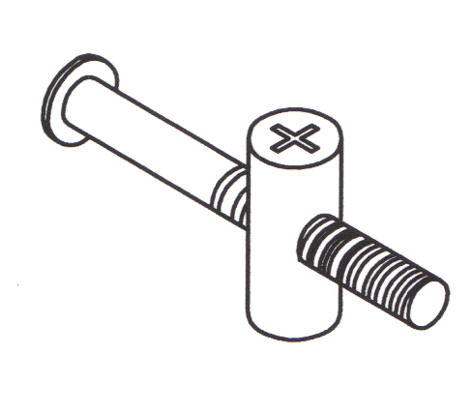
___________________
___________________
___________________
___________________
___________________
___________________
___________________
___________________
___________________
___________________
___________________
___________________
___________________
___________________
___________________
___________________

Slide 4
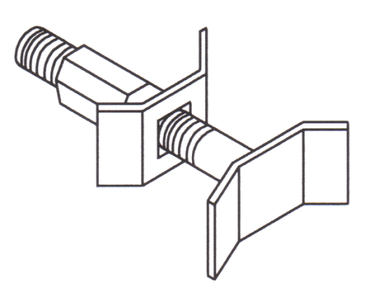
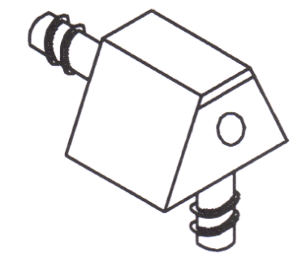
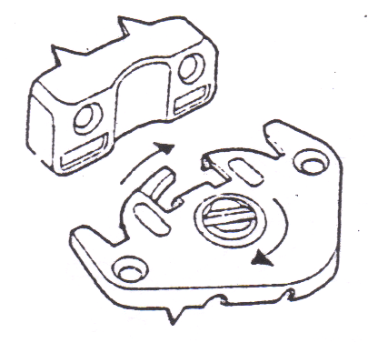
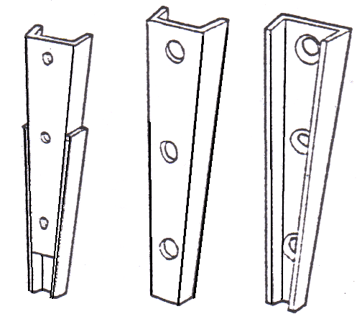
___________________
___________________
___________________
___________________
___________________
___________________
___________________
___________________
___________________
___________________
___________________
___________________
___________________
___________________
___________________
___________________

Slide 5
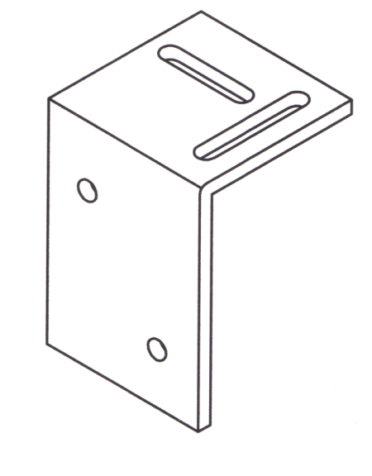
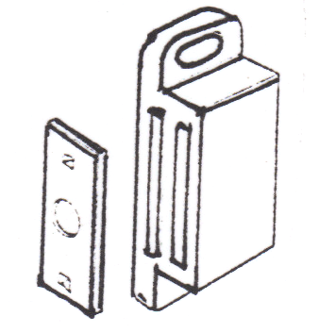
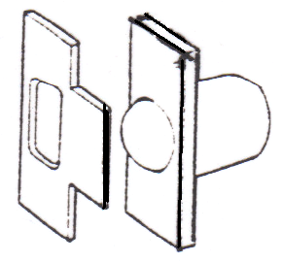
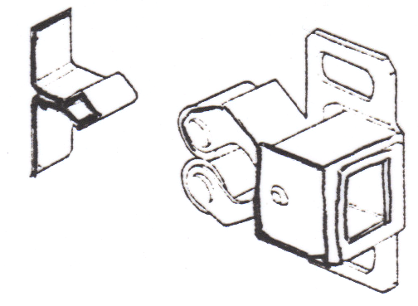
___________________
___________________
___________________
___________________
___________________
___________________
___________________
___________________
___________________
___________________
___________________
___________________
___________________
___________________
___________________
___________________

Slide 6
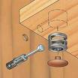
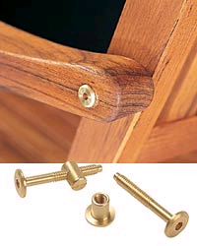
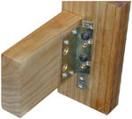

___________________
___________________
___________________
___________________
___________________
___________________
___________________
___________________
_______________________________
_______________________________
_______________________________

Slide 7


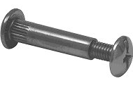
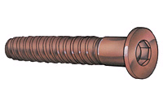
___________________
___________________
___________________
___________________
___________________
___________________
___________________
___________________
___________________
___________________
___________________
___________________
___________________
___________________
___________________
___________________

Slide 8

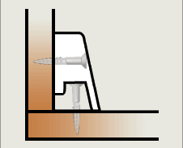
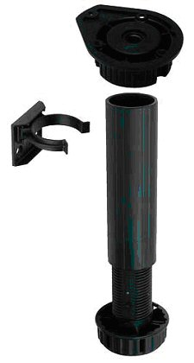
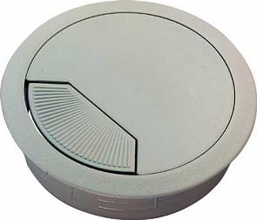
______________
______________
______________
______________

Slide 9





