Slide 1
Laminates & Post forming
Revision

Slide 2
Questions
Q 1. Can Plastic Laminates be laid without the use of a press?
Yes. They can be laid using contact adhesive.
Q 2. What is post forming?
Post forming is bending a flat sheet of laminate over a defined shape heat and even constant pressure.
Q 3. Why is core preparation crucial for laminating.
The surface must be smooth and continuous and free from dust. Any bumps or hollows will show through on the surface of the laminate, esp. on thin or glossy ones.
Q 4. Why use curved surfaces instead of square on worktop edges?
Curved surfaces are less harsh than sharp edges and can reduce the appearance of thicker boards like on Kitchen Worktops.

Slide 3
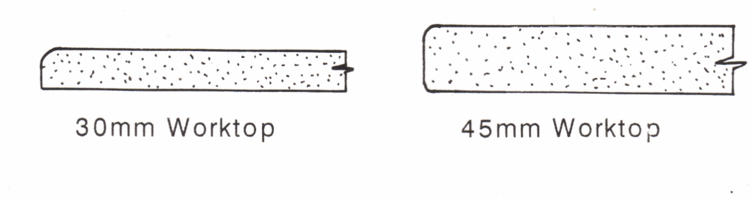
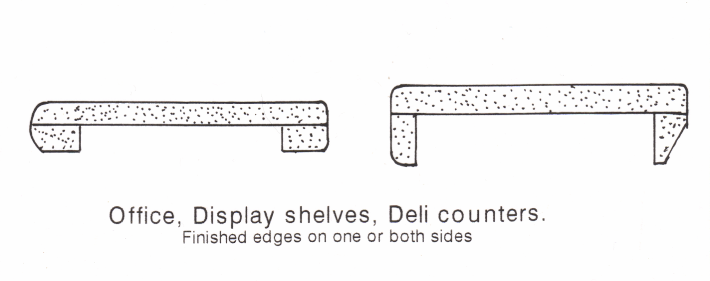
Questions
Q 5. Show using sketches two examples of post formed boards.

Slide 4
Questions
Q 6. Explain briefly how Plastic Laminates are made.
Layers of phenol resin impregnated Kraft paper, a sheet of printed or colored melamine resin impregnated paper and a clear top sheet of melamine are put in a press and bonded together at 1500psi at temp. exceeding 250˚F.
Q 7. Give three advantages for using Plastic Laminates.
Plastic laminate is durable, available in a wide variety of patterns and colours. Plastic laminates have outstanding qualities of likeness, toughness, resistance to heat, moisture, acids etc.

Slide 5
Questions
Q 8. Describe the effect too much heat has on the plastic laminate during the post-forming process
If too much heat is applied to the laminate during the post-forming process the laminate can become discoloured or blistered.
Q 9. Describe how a laminate is post formed over a curved edge.
The panels or worktops with Laminated already stuck to is flat surfaces are placed onto machines using continuous forming process. They pass through an infra red heating zone, which heats the over sailing portion of the laminate, past the stainless steel bars which turn the now softened laminate over the profiled edge.

Slide 6
Questions on Laminates & Post Forming
Q 1. Can Plastic Laminates be laid without the use of a press?
Q 2. Explain briefly how Plastic Laminates are made.
Q 3.Why use curved surfaces instead of square on worktop edges?
Q 4. What is post forming?
Q 5. Give three advantages for using Plastic Laminates.
Q 6. Show using sketches two examples of post formed boards.
Q 7. Why is core preparation crucial for laminating.
Q 8. Describe how a laminate is post formed over a curved edge.
Q 9. Describe the effect too much heat has on the plastic laminate during the post-forming process

