Slide 1
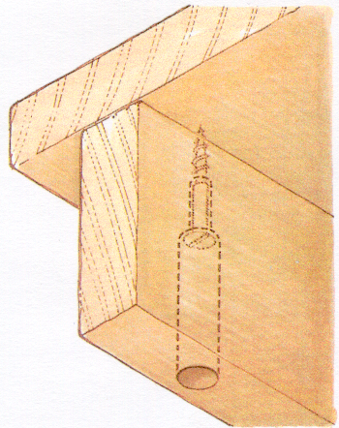
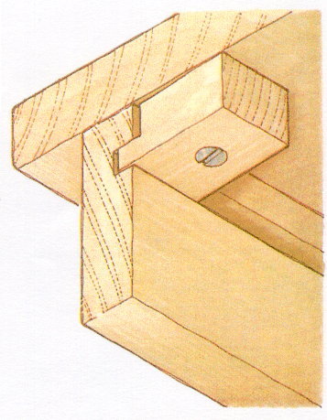
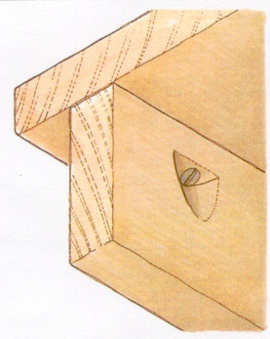
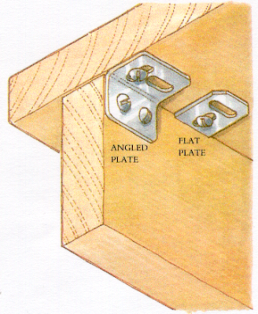
Solid Top Fixing
Name the following methods
A B
C D

Slide 2
Solid Top Fixing
Counter bored Screws: Shrinkage plates :
Allows the use of short screws. Flat plates sunk into the top edge of the rails or
Shank clearance hole should be angled plates are screwed to the inside.
slightly over size to allow movement The slots allow movement in both direction.
Button Fixing Pocket Screws :
A Traditional method using Angled pockets are drilled or
Wooden Buttons to hold the top chiselled into the inside face of the rails
in place while allowing movement. The screw hole can be oversized or slotted.

