Slide 1
Surface
Finishes
On Wood

Slide 2
Timber Preparation
A good surface preparation is essential to achieving a good finish.
Dents, scratches and blemishes in the surface will be enhanced, not hidden, so very careful preparation is needed.
Surplus glue can also show up badly especially on stained work as “orange peel”.

Slide 3
Wood Stains & Finishes
Stains are available in:
Water based stains.
Chemical stains.
Spirit based stains.
Oil based stains.
Solvent based stains.
Water Based
Water tends to raise the grain so its best to pre-treat area by damping the surface and sanding when dry before applying a water-based stain or finish.
Dry pigments that are mixed with water.
Wide range of shades.
Easy to use and resistant to fading.
Very cheap to buy.

Slide 4
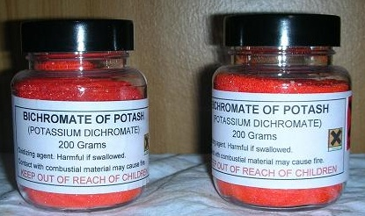
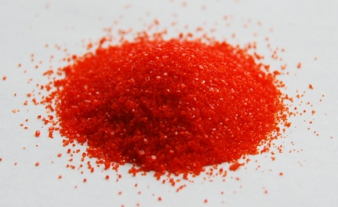
Chemical Stains
Chemicals that react to the tannic acid in timber to change the colour of the wood.
Bichromate of potash. Use this chemical with caution as it is poisonous.
Click link to bring you to webpage where data sheets can be obtained.
http://www.jpennyltd.co.uk/shopping/pgm-more_information.php?id=219

Slide 5
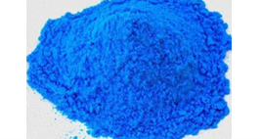
Chemical Stains
Copper sulphate is also known as Blue Vitriol. Dissolve 2 ounces in a pint of water and use this as a stock solution. Use with caution as it is very poisonous.
Ammonia. (extremely dangerous)
Ammonia fumes react chemically with tannins in the wood causing it to permanently change colour. The technique was popularized by Gustav Stickley and other Arts and Crafts furniture makers of his era.
See 3Rd year Website for more info.
You cannot foresee what effect these chemical stains will have on the timber so its best to try them out on a sample first.
For more information on chemicals visit the site below.
http://www.woodfinishingenterprises.com/dyes.html

Slide 6
Spirit based
Dry pigment powder dissolved in methylated spirit and then add French polish.
The polish acts as a binder otherwise the meths. will evaporate leaving behind the pigment.
Difficult to use on large surfaces.
Also tends to fade.
For range of colours click on the link below.
http://www.jpennyltd.co.uk/shopping/pgm-more_information.php?id=262

Slide 7
Oil based
They are slower to dry than water based.
Do not penetrate as much as the rest.
Less chance of overlap marks.
Need plenty of drying time.
Some are non toxic.
Oil polish does not crack or blister or show heat or water marks ideal for garden furniture, table tops, bar counters etc.
Danish Oil
Excellent on pine, it is based on Tung Oil for extra protection and durability. It gives a natural low lustre finish.
Lemon Oil
This provides a suitable finish for teak and matt finished woods where a wax finish is not desired. It has the aroma of fresh lemons.

Slide 8
Oil based (cont.)
Linseed Oil
A natural product available in natural (Non toxic) and boiled form.
Moderate heat and water resistance.
Olive Oil
Used on salad bowls & utensils non toxic.
Teak Oil
Based on Tung Oil and added resins, it gives a quick drying penetrating seal to teak and similar woods. It leaves a slight sheen when dry.
Tung Oil
This oil gives a superior finish to that of linseed oil, and is water-resistant. It can be easily applied using rag.

Slide 9
Solvent based (varnish & stain)
A polyurethane varnish combined with a wood stain, so the stain tends to sit on the surface of the timber rather than being absorbed into it.
Each coat applied will darken the wood further.
Acrylic Varnish
Quick drying and non-toxic, brushes can be rinsed out in water. Available in gloss, satin and matt finishes.

Slide 10
French Polish
Made from pure shellac and methylated spirit
Can produce a good finish on furniture.
A high gloss can be achieved by applying numerous thin coats
In addition to standard French Polish, other options are available
White Polish made from bleached white shellac.
Button Polish made with button shellac, producing a more orange colour.
Ebony Polish, gives a jet-black finish when applied.
Garnet Polish gives an attractive deep rich brown cast to wood.
Applied in numerous coats using a fad and sanding in between coats.
Used for repairing antiques.

Slide 11
Wax Polish
A good quality wax polish with added beeswax will gently lift and remove grime.
Wax gives a hard protective coating with a natural sheen.
Traditional wax has no added oils, colour or perfume.
Wax Polishes are available in a number of forms including liquid, paste, a special brushing wax, coloured waxes and staining waxes.

Slide 12
Lacquer
Four basic types
Nitrocellulose
Polyurethane
Acid- Catalyzed
Polyester
Lacquers and paints give a harder and more resistant finish than French polish, Wax or oils.
They are generally applied by brush or spray gun.
Available in gloss, satin and matt finishes.

Slide 13
Lacquer Health & Safety
Some lacquers are toxic and inflammable so safety precautions should be taken.
Wear proper respiratory mask to protect your eyes, nose and mouth.
Spray in a well ventilated room.
Always check pressure valves and clocks when you first turn on the compressor.
Water based lacquers are now widely available and the offer the same properties but without the toxins.

Slide 14
Nitrocellulose
Cheap
Quick drying
Produces a hard heat and moisture proof
Used on kitchen doors, cabinets, chairs and other furniture.
Polyurethane
Expensive.
Excellent hard surface.
Good heat, moisture and wear resistant properties.
As water based product often used as a floor sealer, leaves no brush marks, excellent resistance to wear and tear.

Slide 15
Acid-catalyzed (AC lacquers)
Expensive.
Produces a very durable heat and moisture proof surface.
Layers set by polymerization.
Repairs to this surface are not easy to do.
Tough finish used on furniture, kitchen doors etc.
Polyester
Expensive.
Hardest and most durable of all the lacquers
It dries fast so can only be applied with spray gun.
One coat is sufficient.
High gloss finish cannot be repaired if scratched. Item will have to be stripped and refinished.

